Slide 1


Project Application:
TimeFlow
By Damiano Miloncini, Michaëlla Nsumanyi, Santiago Garcia

Slide 2
What is TimeFlow
January
Mon | Tue | Wed | Thu | Fri | Sat | Sun
 |  |  |  |  | 01 | 02
03 | 04 | 05 | 06 | 07 | 08 | 09
10 | 11 | 12 | 13 | 14 | 15 | 16
17 | 18 | 19 | 20 | 21 | 22 | 23
24 | 25 | 26 | 27 | 28 | 29 | 30
31
TimeFlow is a Graphical User Interface application created to help student overcome time management challenges in their everyday life.

Slide 3
User Manual
User login
User either creates a new account or connects to its existing account.
Week of December 4th-8th
04 | 05 | 06 | 07 | 08 | 09 | 10
Home Page
Task 1
The home page displays key information such as time, date, and task of the day
Task 2
Task 3
Task 4
Task Page
Displays all the tasks that belongs to the logged in user. User has the option to add and or delete tasks

Slide 4
User Manual (Continued)
Calendar Page
Displays a calendar view. User can choose between the monthly, weekly or daily view. User can also directly add task to the calendar.
Week of December 4th-8th
04 | 05 | 06 | 07 | 08 | 09 | 10
Task 1
Task Matrix Page
Task 2
User is able to view their task by priority.
Task 3
Task 4
Help & Settings
User has access to the User Manual document by clicking the help button.

Slide 5
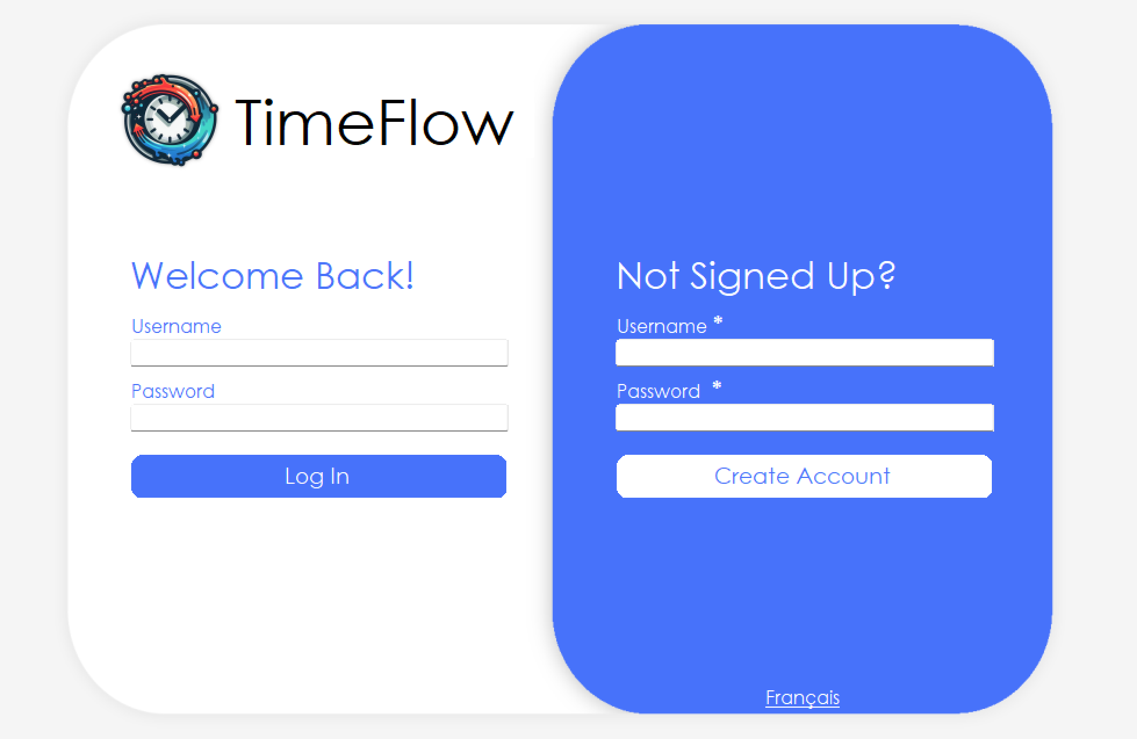
Demo Time !!

Slide 6

THANK YOU !!

